Slide 1

Using AI to Content Creation
& Communication to Patients
Masoud Shahabian, MD & DBA (in AI)
Emergency Medicine Specialist, Besat Hospital of NAHAJA,
AJA University of Medical Science,Tehran, Iran.

Slide 2
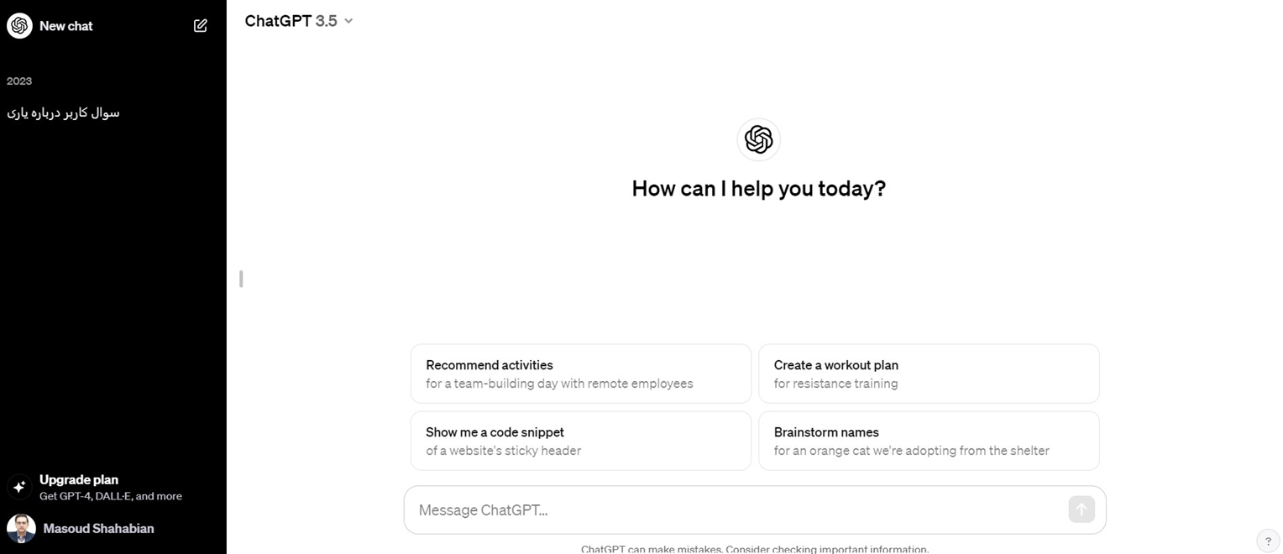
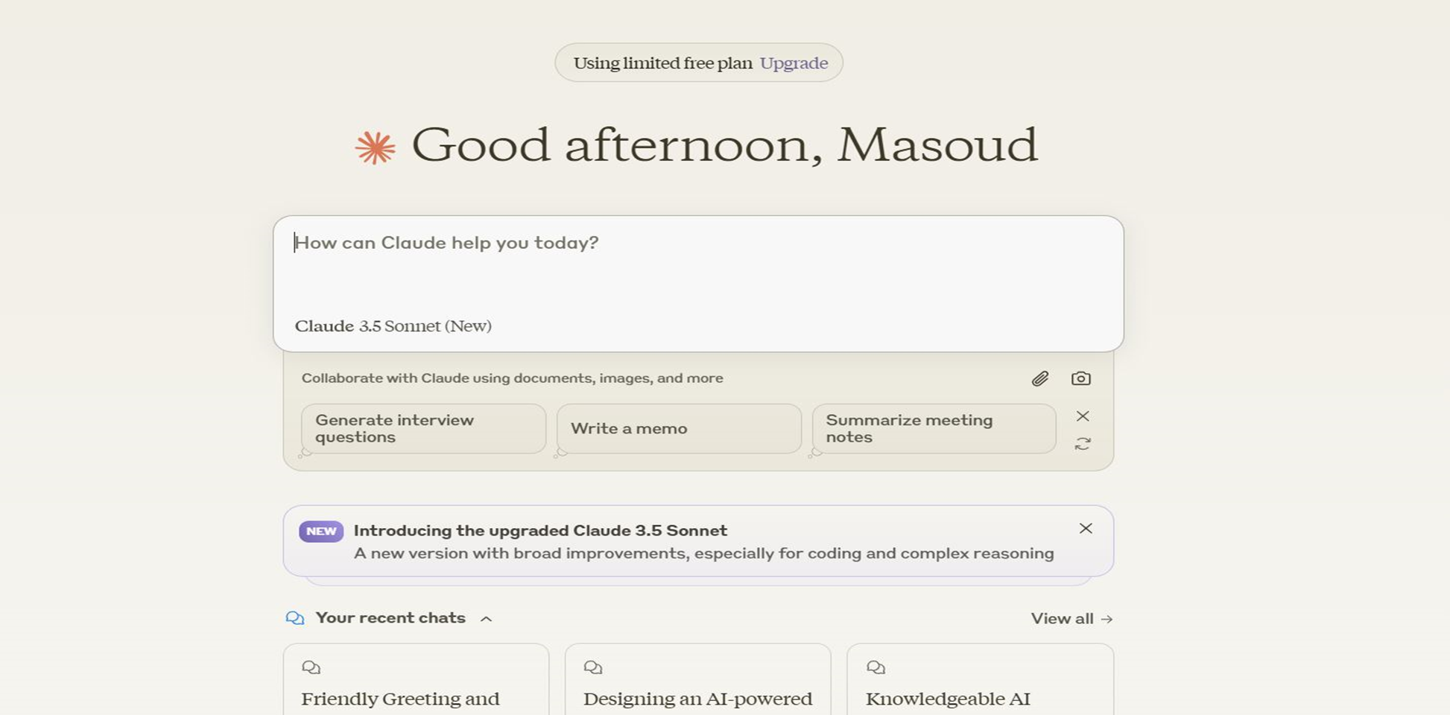
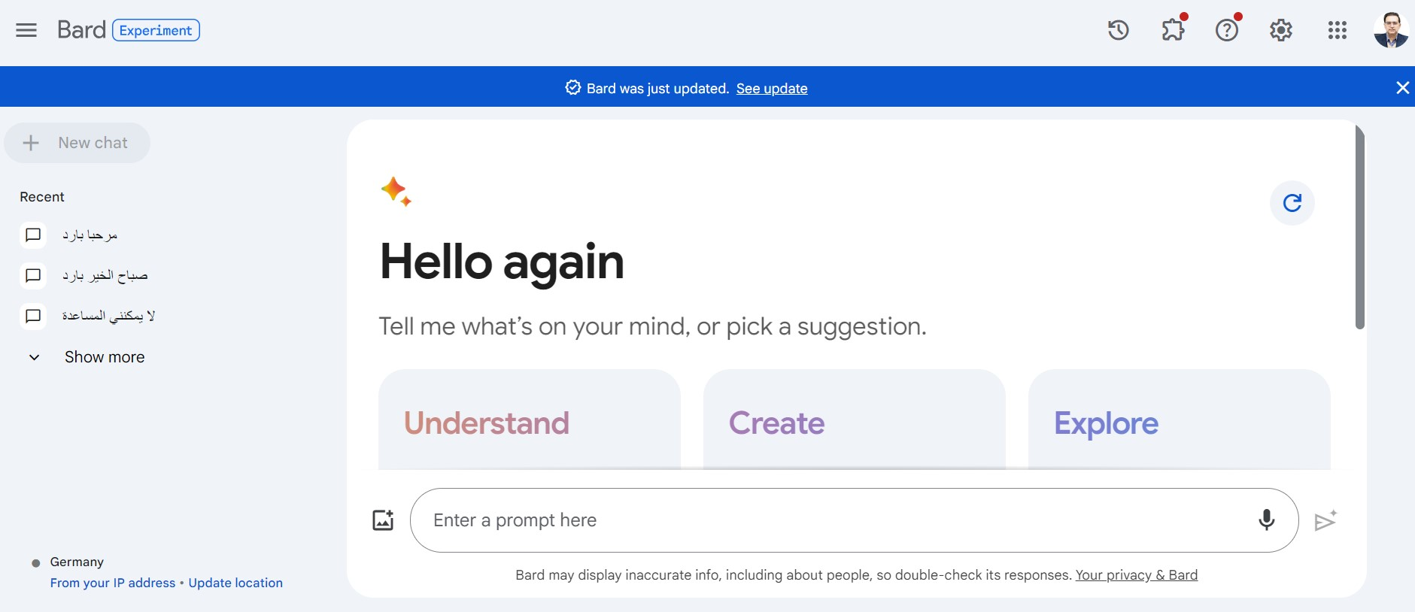
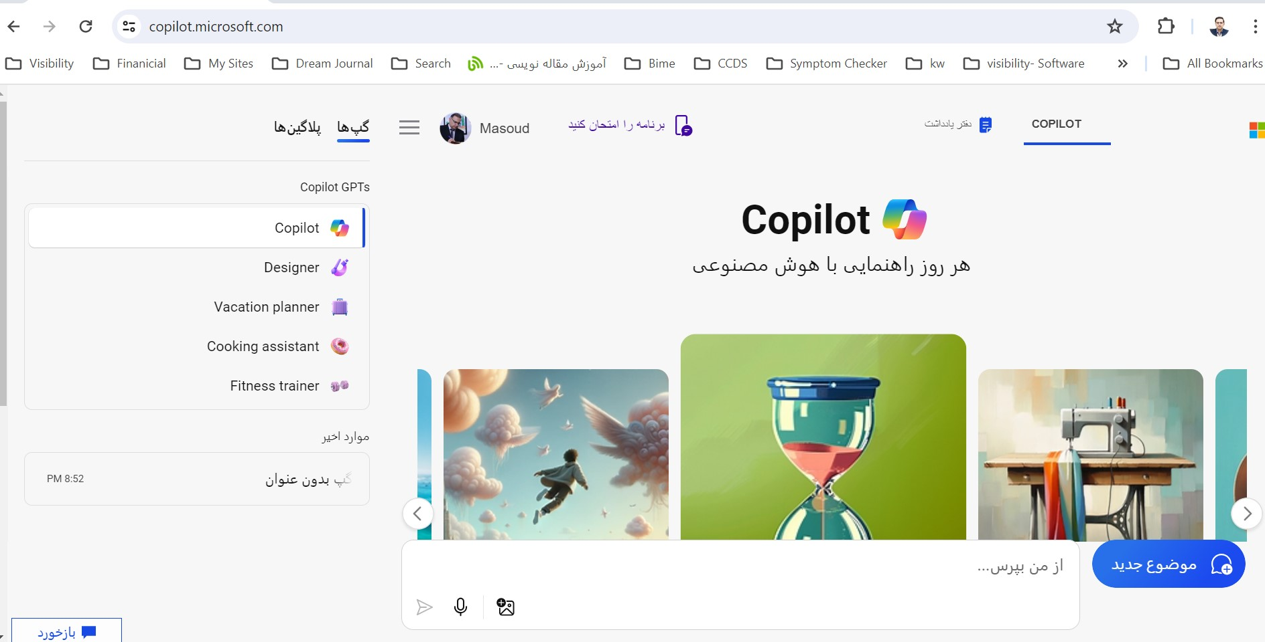
Generative AI

Slide 3
Interaction to AI
Text
Voice
Video

Slide 4
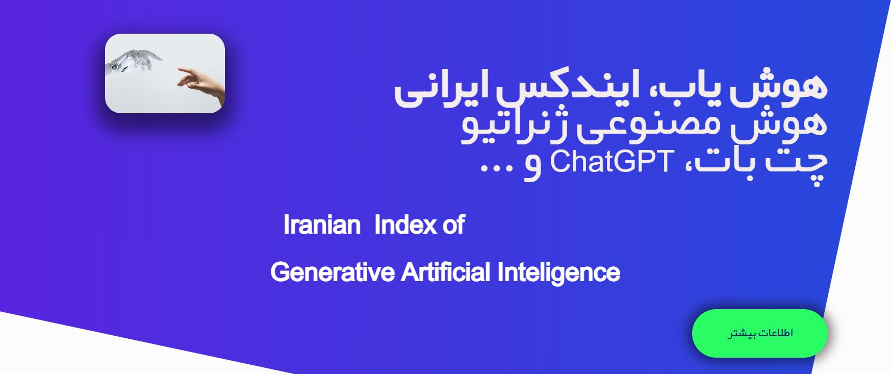
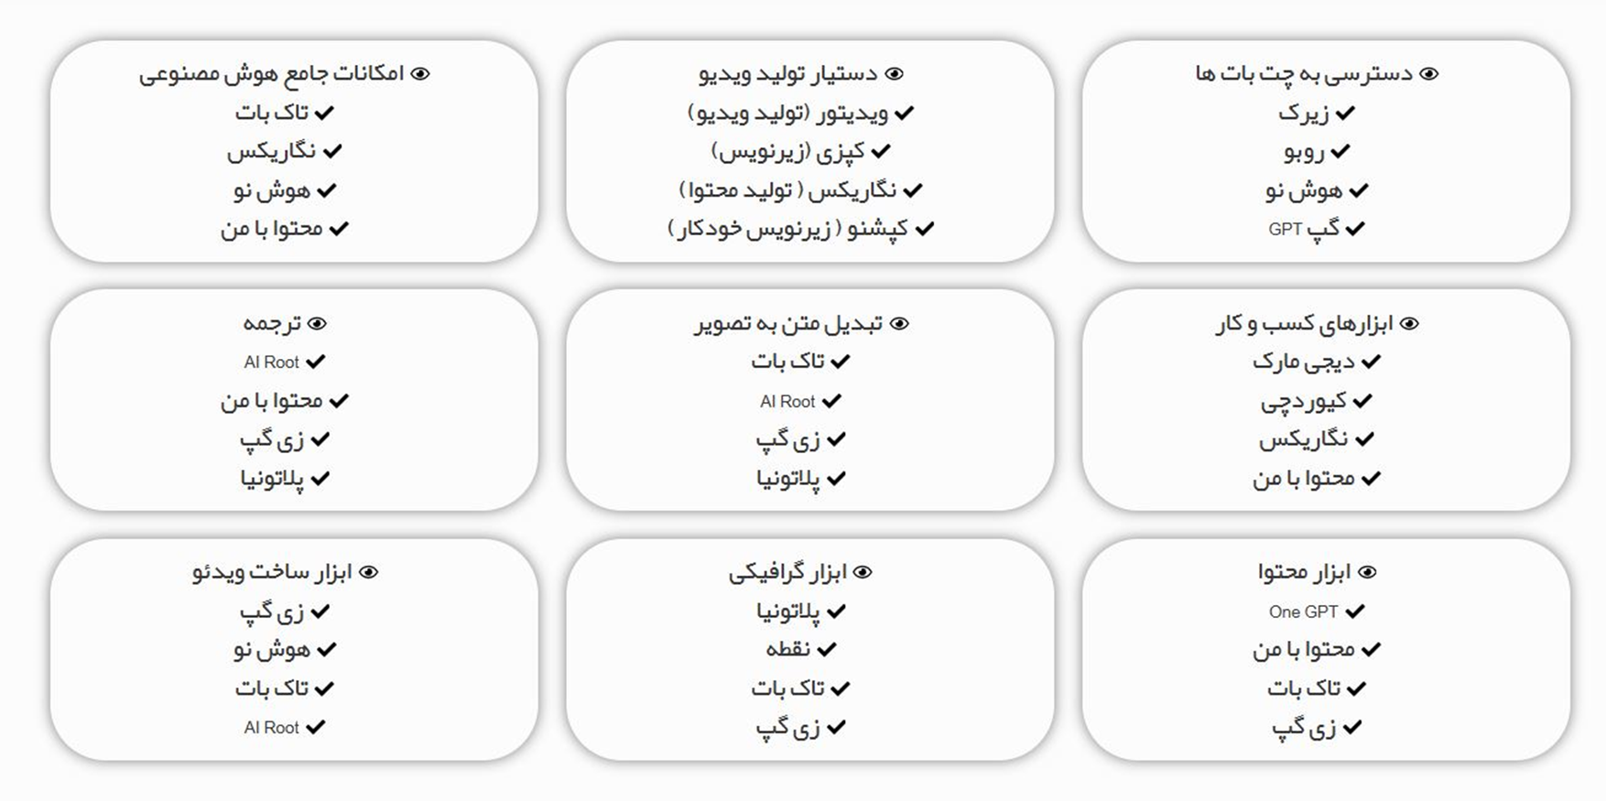
Interaction to AI ➔ Text
www.hosh-yab.ir
https://mu.chat/

Slide 5

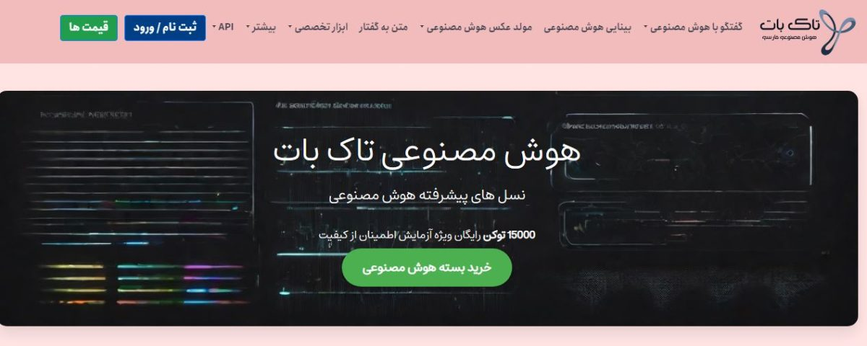
Interaction to AI ➔ Voice
Chatgpt
talkbot

Slide 6
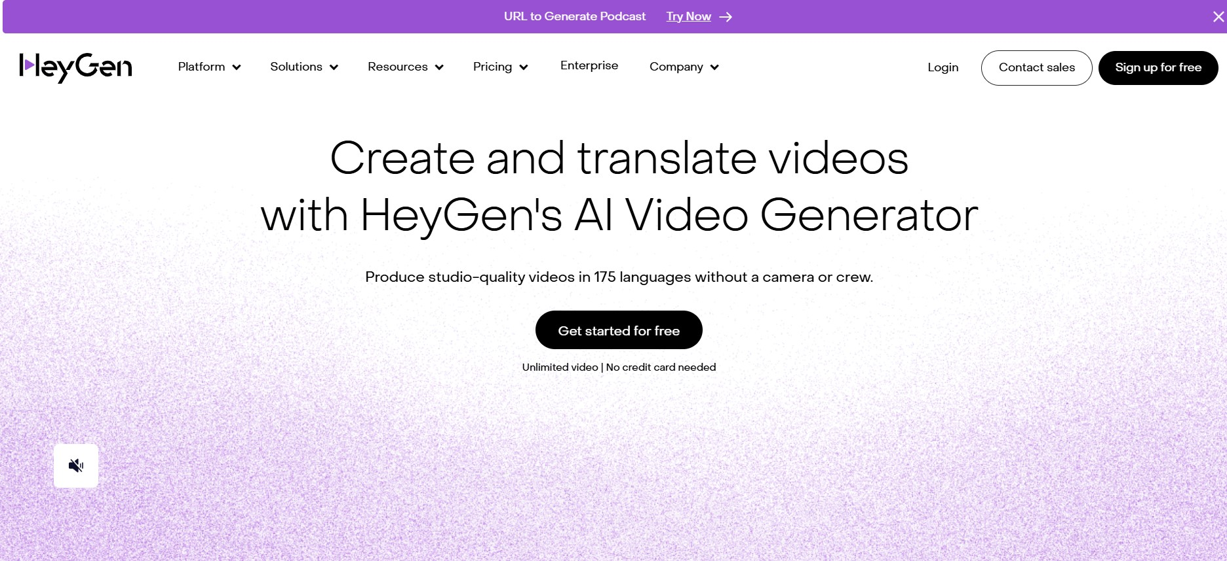

Interaction to AI ➔ Video
www.d-id.com
www.heygen.com

Slide 7
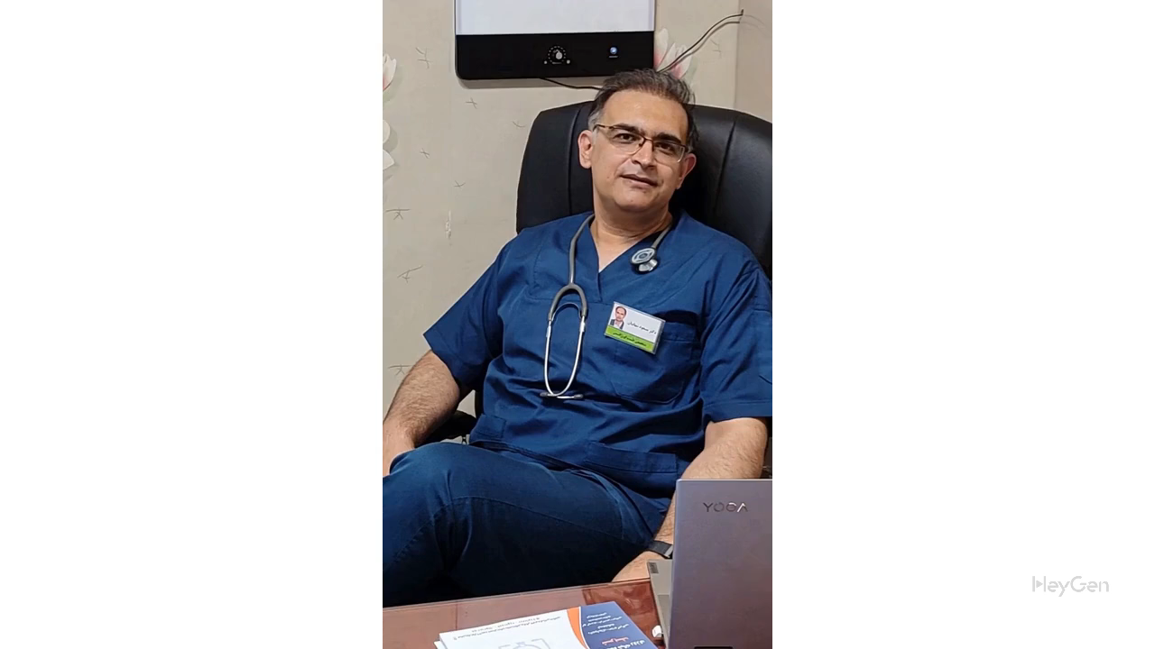

Slide 8
https://B2n.ir/w92370
با آرزوی موفقیت
مسعود شهابیان
12 دی 1403

