Slide 1
Using Artificial Intelligence to business Promotion
Masoud Shahabian, MD & DBA (in AI)
Emergency Medicine Specialist, Besat Hospital of NAHAJA,
AJA University of Medical Science,Tehran, Iran.

Slide 2
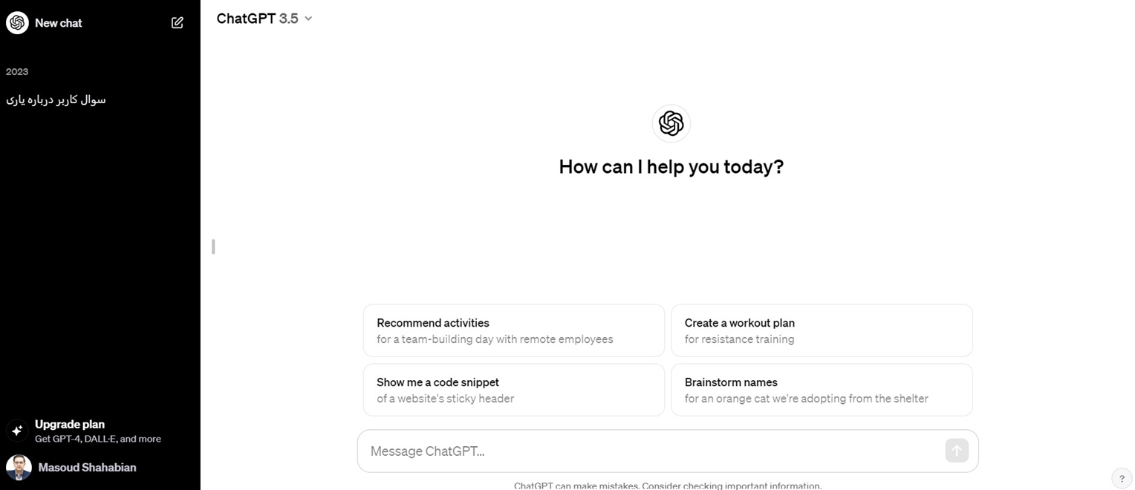
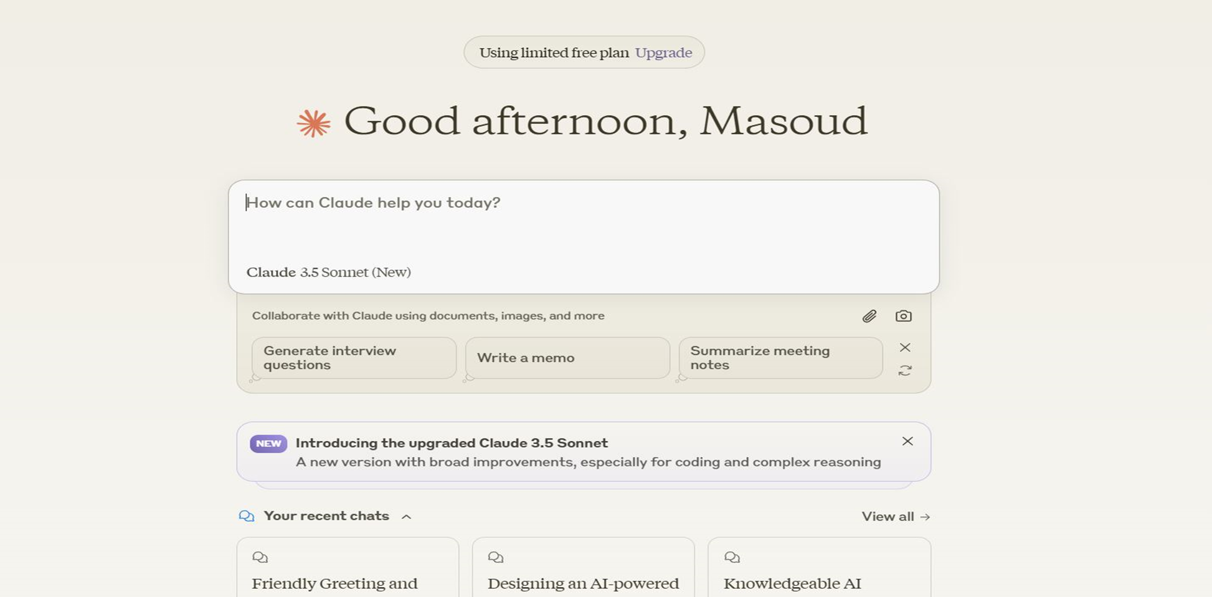
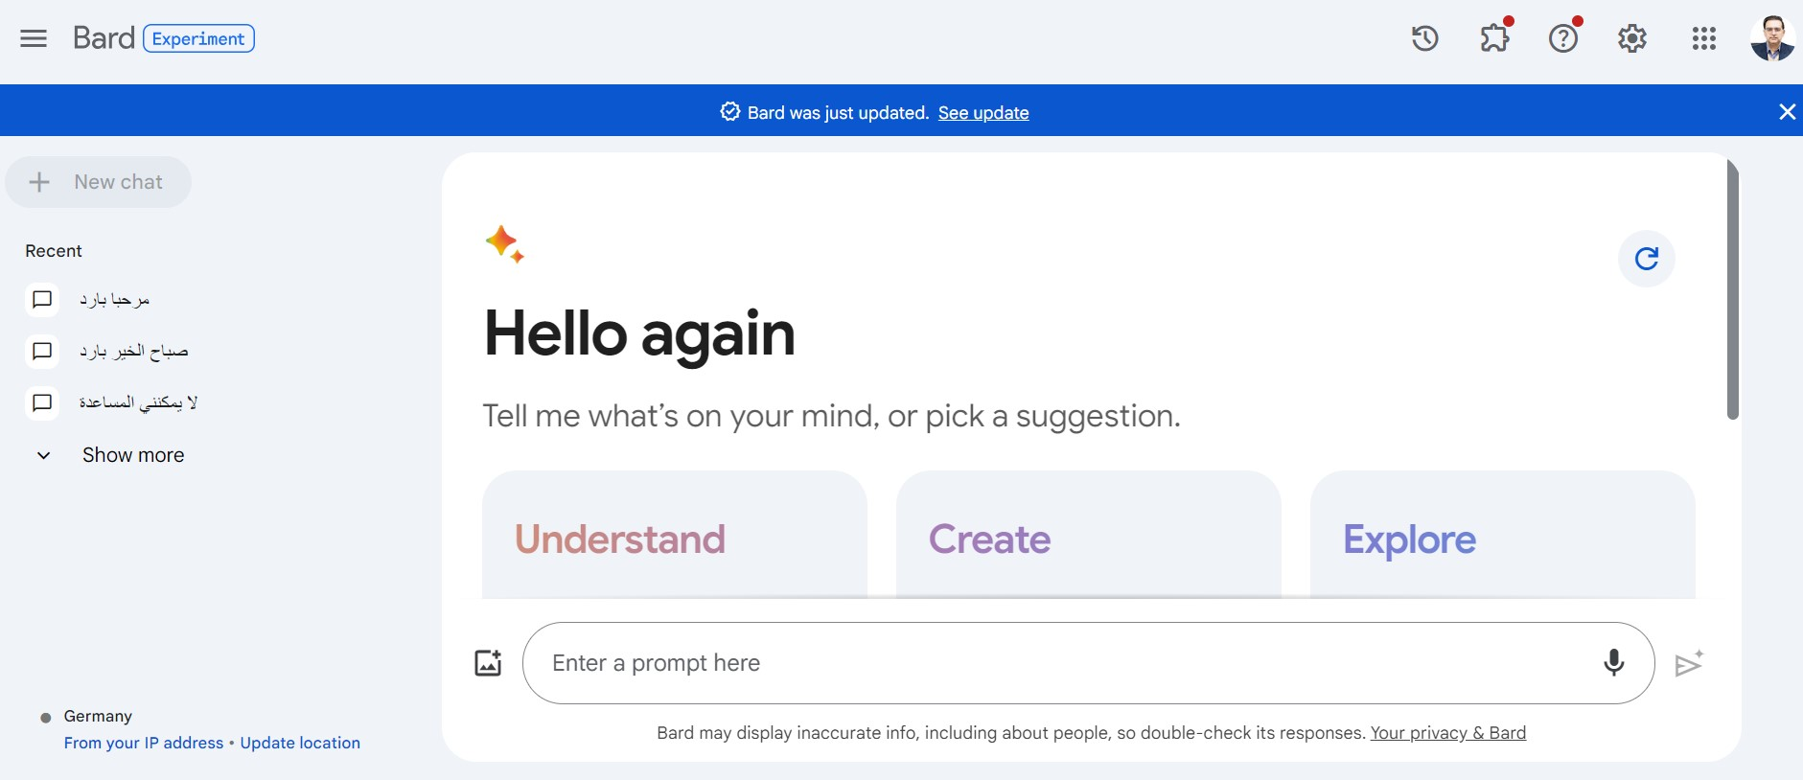
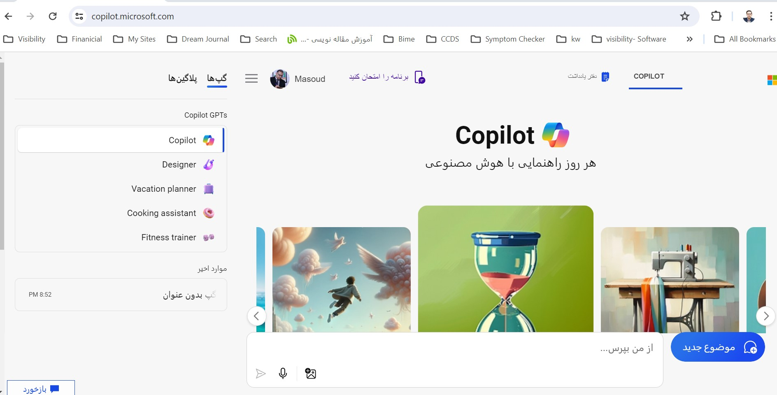
Generative AI

Slide 3
Interaction to AI
Text
Voice
Video

Slide 4
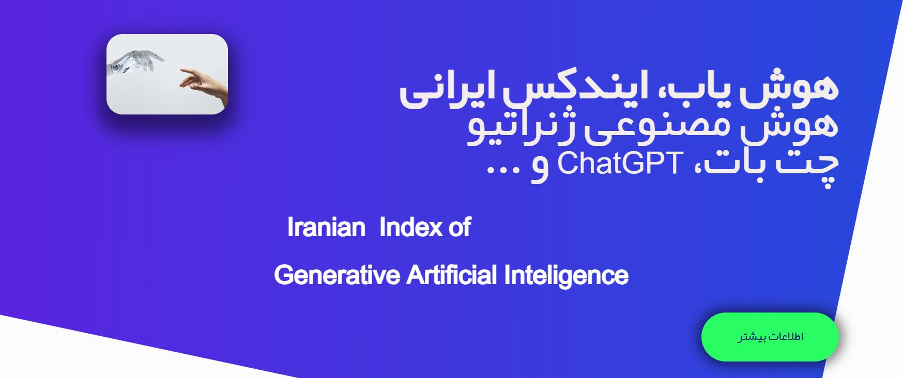
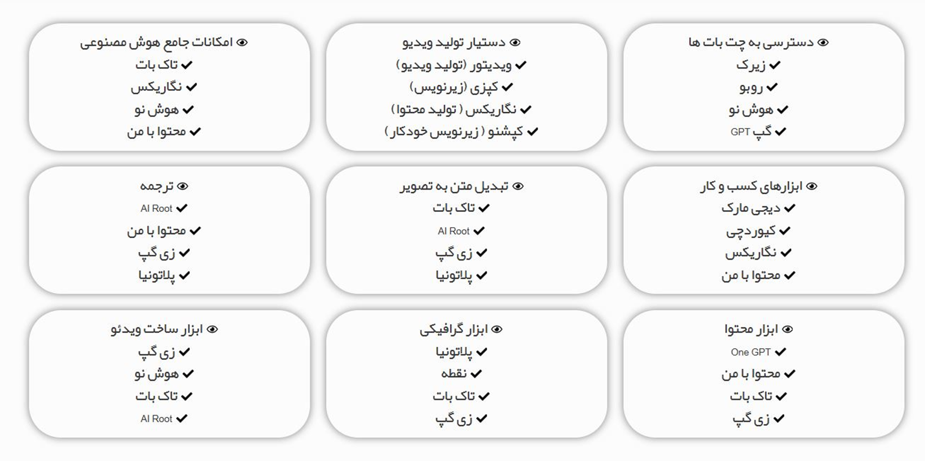
Interaction to AI ➔ Text
www.hosh-yab.ir
https://mu.chat/

Slide 5

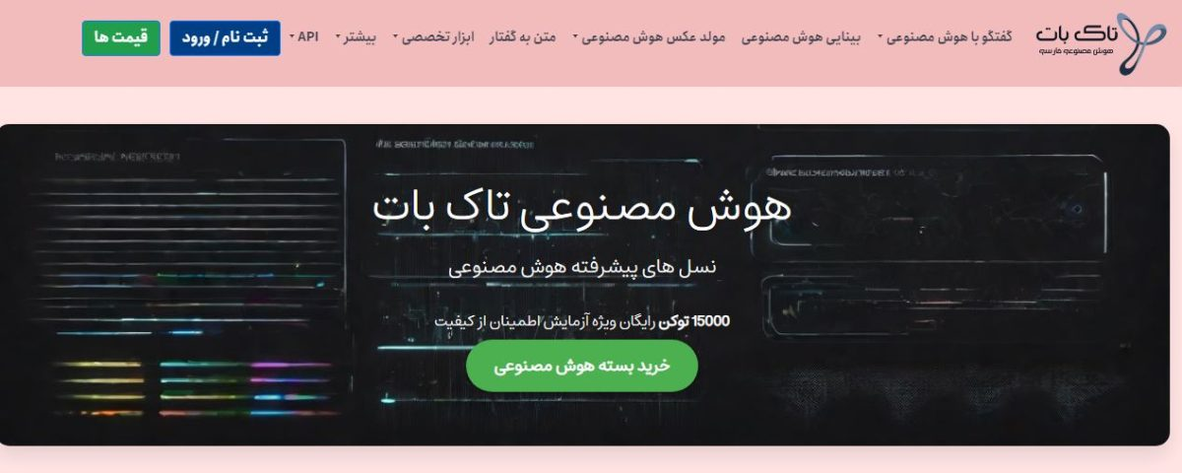
Interaction to AI ➔ Voice
Chatgpt
talkbot

Slide 6
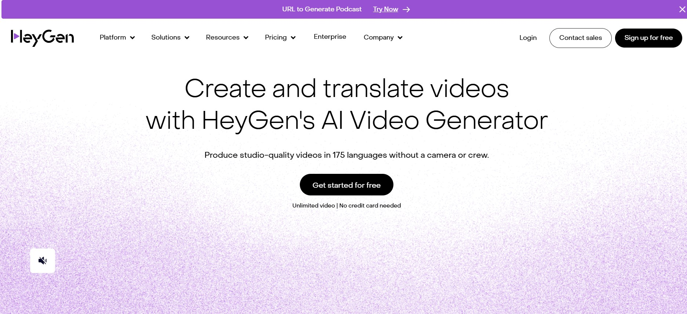
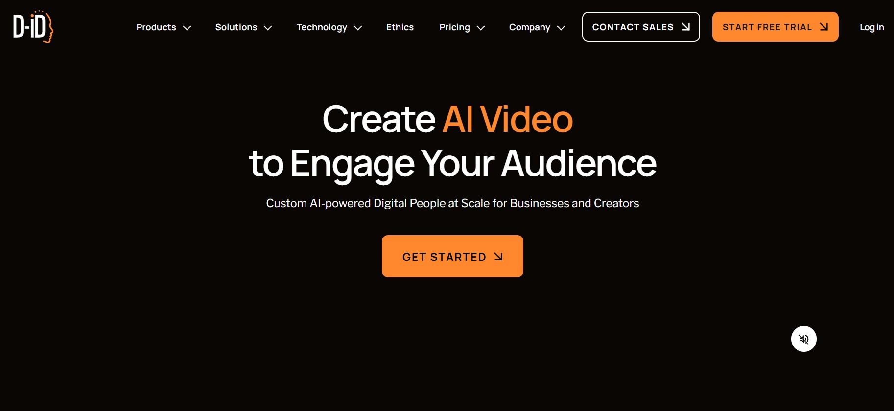
Interaction to AI ➔ Video
www.d-id.com
www.heygen.com

Slide 7
با آرزوی موفقیت
مسعود شهابیان
15 دی 1403

